Slide 1
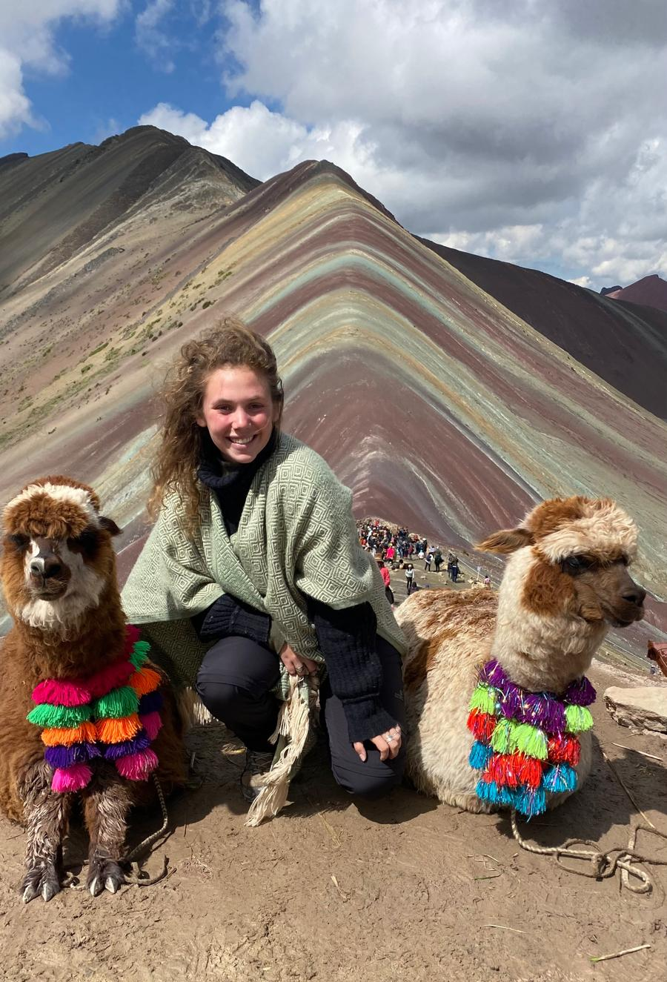
Alpaca or Not Alpaca
Image Classification with fastai
Deep Learning – Exercise 1
Mor Greenberg

Slide 2
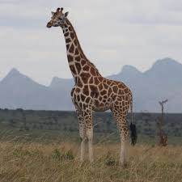
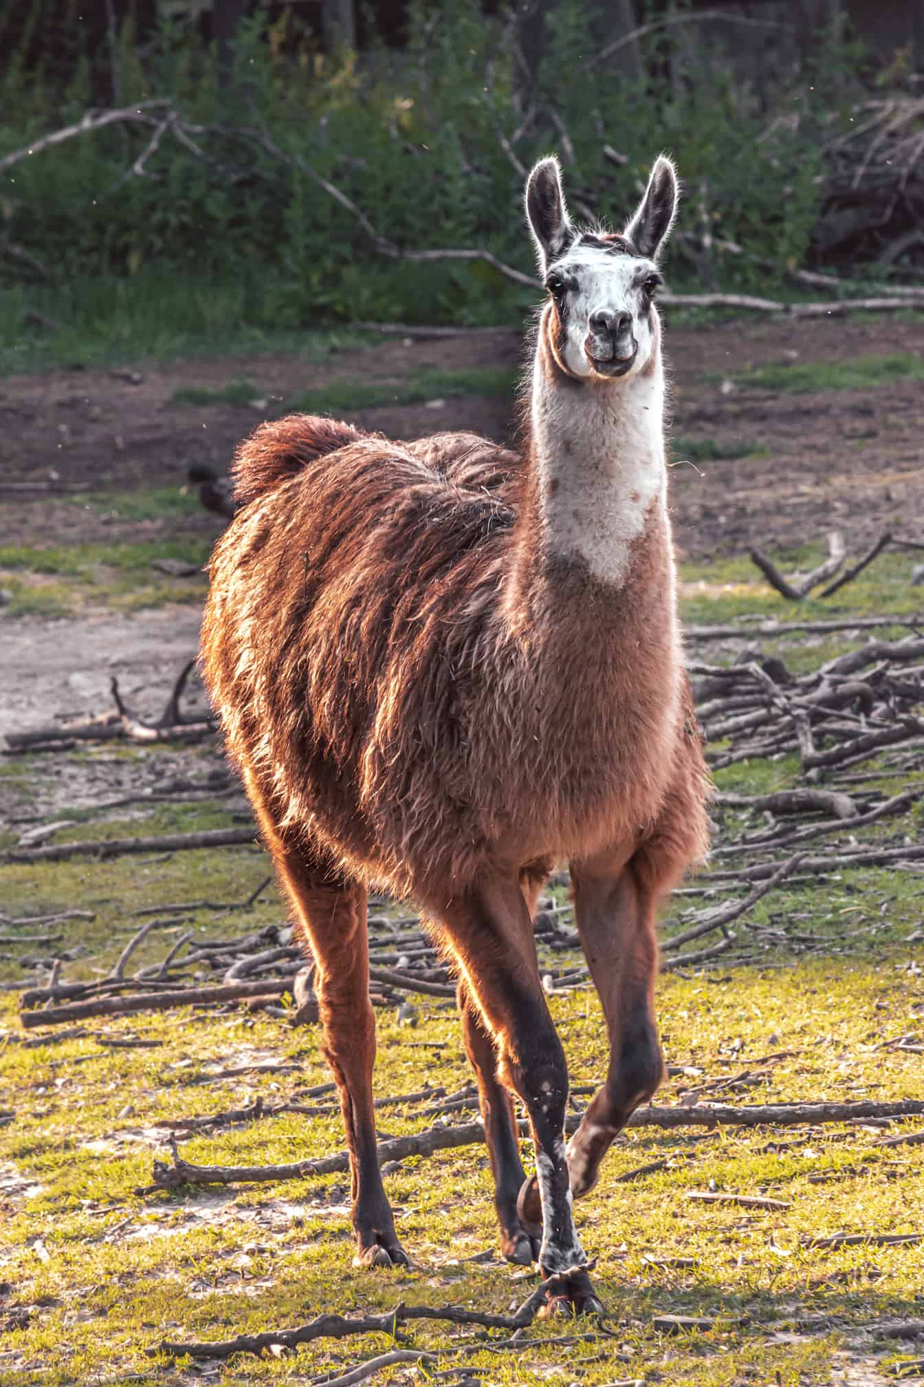
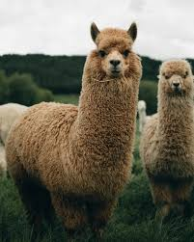
Problem Definition
Binary image classification task
Determine whether an image contains an alpaca or not
Motivation:
I love alpacas
Content filtering
Wildlife image analysis
Main challenges:
Visual similarity to llamas, camels, giraffes
Variations in scale, pose, and background

Slide 3
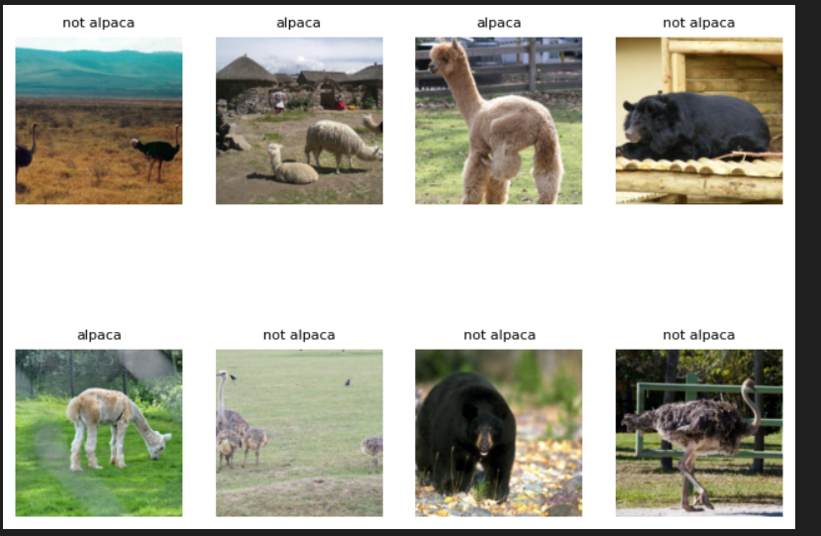
Dataset
Two classes:
alpaca (142 images)
not alpaca (185 images)
Images collected from Kaggle
Dataset organized into class-labeled folders
Show_batch() from the notebook

Slide 4
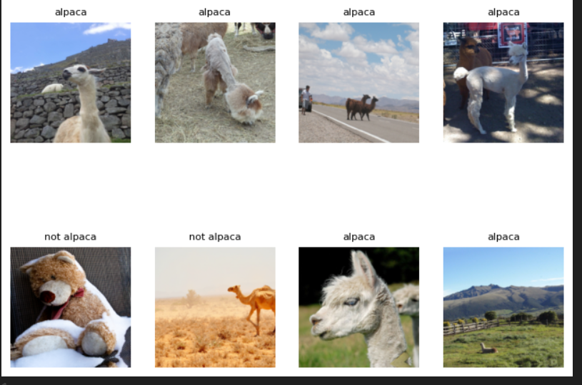
Data Pipeline
fastai ImageDataLoaders
Train/validation split (80% / 20%)
Image resizing to 224×224
Same preprocessing for all experiments
Example Training Images After Data Augmentation

Slide 5
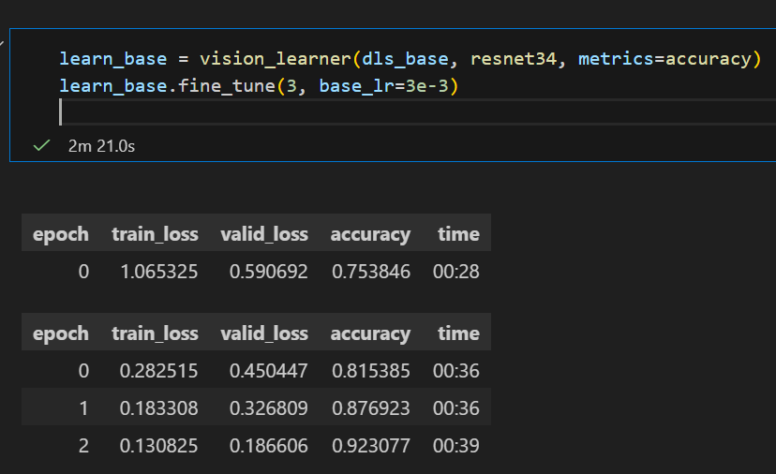
Model Architecture
Baseline Model
Transfer learning with ResNet 34
Trained for 3 epochs
Metric: Accuracy
ResNet34 convolutional neural network
Pretrained on ImageNet
Transfer learning:
Replace classification head
Fine-tune entire network
Metric: Accuracy

Slide 6
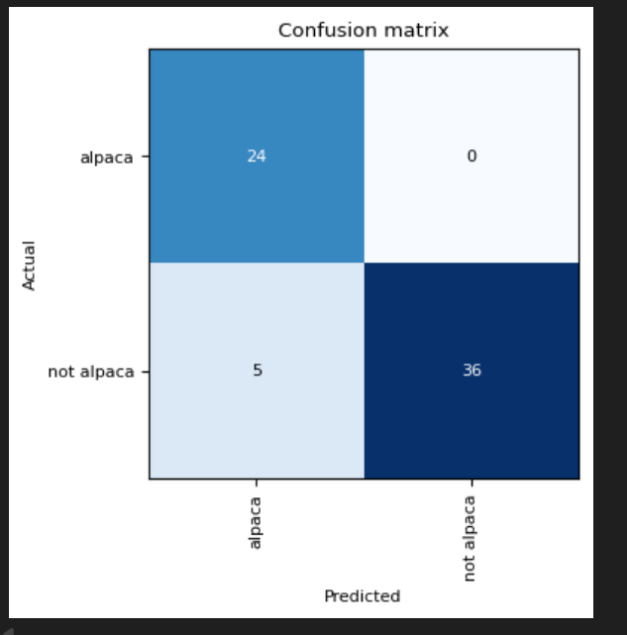
Model Architecture
Baseline Results
Validation accuracy: 92.31%
Alpaca recall: 100%
Strong performance

Slide 7
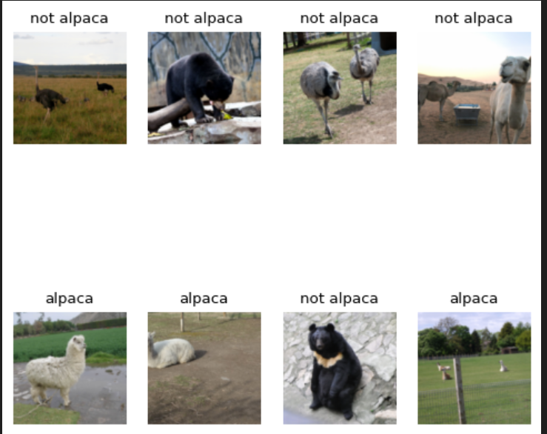
Data Augmentation Experiment
Added standard augmentations:
rotation, zoom, lighting
Same model (ResNet34)
Same number of epochs (3)
Goal: improve robustness and generalization

Slide 8
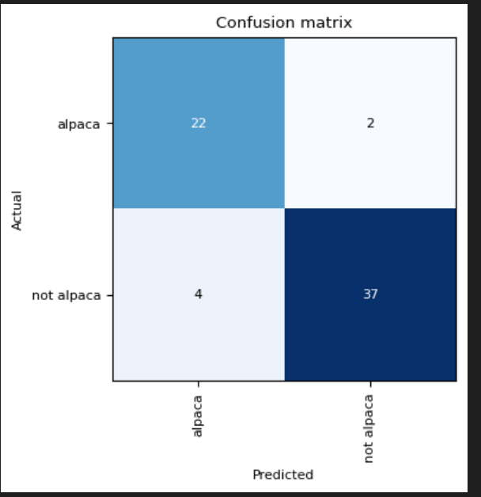
Augmentation Results
Validation accuracy: 90.76%
Alpaca recall: 91.7%
Performance decreased compared to baseline
Augmentation may distort fine-grained features

Slide 9
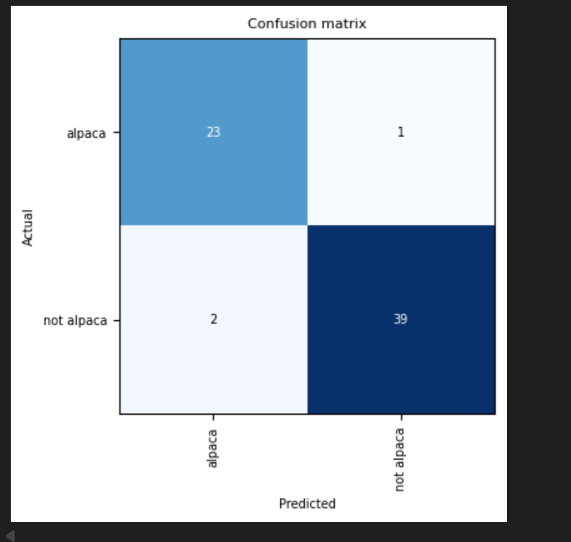
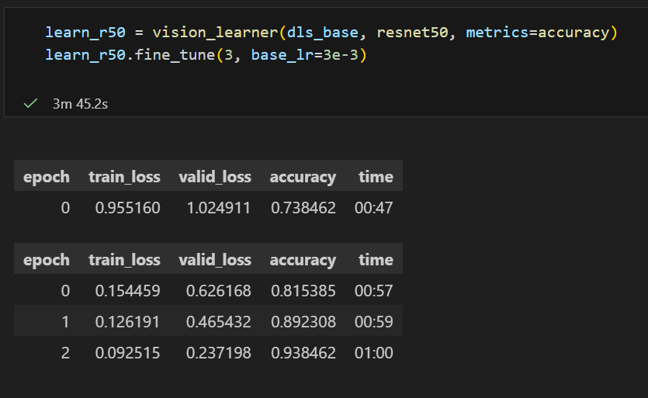
Improved Results
Deeper Model: ResNet50
Tested a deeper backbone: ResNet50
Same dataset, same epochs (3)
Goal: evaluate effect of
increased model capacity

Slide 10
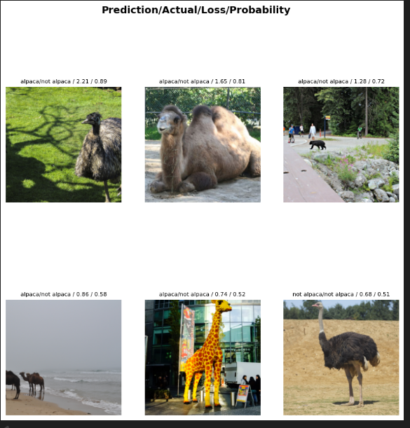

Error Analysis
Remaining errors occur for:
Animals with similar shape (giraffes, camels)
Partial or distant subjects
Model relies heavily on body shape and neck features

Slide 11
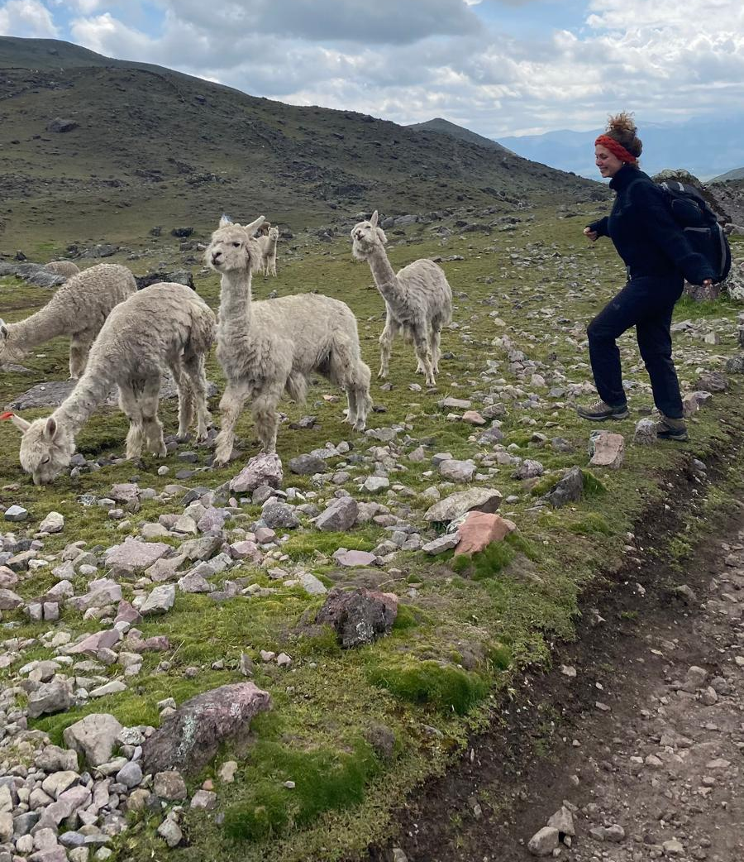
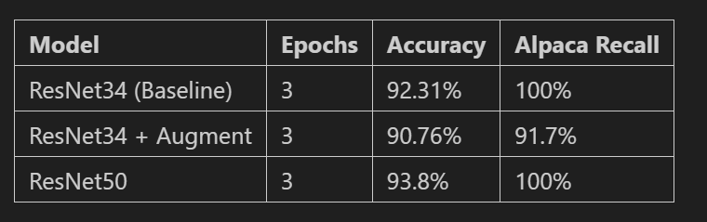
Model Architecture
Final Comparison & Conclusions
Best accuracy: ResNet50 - 93.8%
Best recall : ResNet34 baseline and ResNet50 - 100%
Deeper model → marginal improvement
Augmentation did not help for this dataset

